Slide 1

INCIDENT: Ransomware Attack Response
Incident Timeline: March 24, 2026

Slide 2
INCIDENT RESPONSE REPORT
Executive Summary
Incident ID
Severity
INC-2026-0324-001
CRITICAL
Status
Detection Time
RESOLVED
09:15 AM UTC
Resolution Time
Total Duration
01:45 PM UTC
4 hours 30 minutes
A ransomware attack (LockBit variant) was detected on 3 endpoints in the Finance department. The Blue Team successfully contained, eradicated, and recovered all systems with zero data exfiltration.

Slide 3
WORKFLOW
STEP 1: PREPARE (Pre-Incident)
Time: Before 09:15 AM
Blue Team Preparation
SIEM (Splunk) monitoring 500+ systems
EDR (CrowdStrike) deployed on all endpoints
IDS/IPS (Suricata) monitoring network traffic
SOAR (Palo Alto XSOAR) playbooks configured
Incident response team on standby
Backup systems verified (last backup: 08:00 AM)

Slide 4
STEP 2: DETECT
Time: 09:15 AM UTC
ALERT TRIGGERED
What the Blue Team saw — SIEM Dashboard Alert
Source: EDR (CrowdStrike Falcon)
Alert: "Suspicious file encryption activity detected"
┌─────────────────────────────────────────┐
│ RANSOMWARE DETECTION - HIGH CONFIDENCE │
├─────────────────────────────────────────┤
│ Host: FINANCE-LAPTOP-042 │
│ User: jsmith@company.com │
│ Process: powershell.exe (suspicious) │
│ File Extensions: .lockbit (RANSOMWARE) │
│ Files Encrypted: 1,247 files in 2 min │
│ Alert Confidence: 99% │
└─────────────────────────────────────────┘
Host: FINANCE-LAPTOP-042 (John Smith, Finance Analyst)
Process: explorer.exe → cmd.exe → powershell.exe
Activity: Rapid file encryption (.lockbit extension)
Files Affected: C:\Users\jsmith\Documents\*.lockbit
Time: 09:15:23 AM UTC
Status: CRITICAL - Ransomware suspected

Slide 5
STEP 3: ANALYZE
Time: 09:16 AM – 09:28 AM (12 minutes)
1
2
3
L1 Analyst (09:16 AM) — Triage
L2 Analyst (09:18 AM) — Investigation
L3 Analyst (09:25 AM) — Advanced Analysis
Alert is TRUE POSITIVE (not false alarm)
Confidence: 99% → Ransomware confirmed
Escalate to L2 immediately
Found: 2 more hosts — FINANCE-LAPTOP-051 (Sarah Johnson), FINANCE-LAPTOP-068 (Mike Chen)
IOC Match: File hash matches known LockBit variant
C2 Domain: 185.143.222.10 (known LockBit server)
Outbound connection detected; ~2.3 GB transferred
Entry point: Phishing email attachment "Invoice.exe"
Lateral movement: Attempts to access shared drives
Volatility: Found injected code in explorer.exe; identified persistence mechanism (Registry Run key); extracted C2 communication logs
Wireshark: Confirmed C2 beaconing every 30 seconds; identified data exfiltration protocol (HTTPS + AES-256); mapped attacker infrastructure
Scope Assessment — IMPACT ANALYSIS
Affected Systems: 3 endpoints
├─ FINANCE-LAPTOP-042 (John Smith) - 1,247 files encrypted
├─ FINANCE-LAPTOP-051 (Sarah Johnson) - 892 files encrypted
└─ FINANCE-LAPTOP-068 (Mike Chen) - 654 files encrypted
Affected Users: 3
Affected Departments: Finance (1), Accounting (2)
Data Compromised: 2.3 GB exfiltrated (customer data)
Business Impact: HIGH - Finance operations disrupted
Ransomware Variant: LockBit 3.0
Attacker: APT-LOCKBIT (Russian cybercriminal group)

Slide 6
STEP 4: CONTAIN
Time: 09:28 AM – 09:42 AM (14 minutes)
Immediate Actions (09:28 AM)
Ransomware Note Found
EDR Actions (Automated via SOAR):
╔════════════════════════════════════════╗
║ YOUR FILES HAVE BEEN ENCRYPTED ║
║ ║
║ LockBit 3.0 Ransomware ║
║ Contact: lockbit@protonmail.com ║
║ Ransom: $500,000 USD ║
║ Deadline: 48 hours ║
║ Data will be sold if not paid ║
╚════════════════════════════════════════╝
Isolate FINANCE-LAPTOP-042 from network → ISOLATED
Isolate FINANCE-LAPTOP-051 from network → ISOLATED
Isolate FINANCE-LAPTOP-068 from network → ISOLATED
Kill malicious processes: powershell.exe (PID: 4521) → TERMINATED; cmd.exe (PID: 3847) → TERMINATED; Invoice.exe (PID: 2156) → TERMINATED
Firewall Actions (Automated via SOAR):
Block C2 domain: 185.143.222.10 → BLOCKED
Block all outbound HTTPS to suspicious IPs → BLOCKED
Account Actions (Manual):
Status at 09:42 AM
jsmith@company.com → DISABLED
sjohnson@company.com → DISABLED
mchen@company.com → DISABLED
Force password reset for Finance team (50 users) → IN PROGRESS
Attack contained
Lateral movement blocked
C2 communication cut off
No further encryption possible
Network Segmentation (Manual):
Isolate Finance VLAN from other departments → SEGMENTED

Slide 7

STEP 5: ERADICATE
Time: 09:42 AM – 11:15 AM (1 hour 33 minutes)
Forensic Collection (09:42 AM)
Malware Removal (10:00 AM)
Forensic image: FINANCE-LAPTOP-042.img (256 GB), FINANCE-LAPTOP-051.img (512 GB), FINANCE-LAPTOP-068.img (256 GB)
Memory dumps: FINANCE-LAPTOP-042.mem (16 GB), FINANCE-LAPTOP-051.mem (16 GB), FINANCE-LAPTOP-068.mem (16 GB)
Logs collected: SIEM (Splunk), EDR (CrowdStrike), Firewall (Palo Alto)
Boot systems in Safe Mode
Malwarebytes scan: Detected 47 malware files → Removed 47 malware files
Registry Run keys → DELETED; Startup folder items → DELETED; Scheduled tasks → DELETED
Windows Update KB5034441 → INSTALLED; Adobe Reader patch → INSTALLED; Microsoft Office patch → INSTALLED
Vulnerability Patching (10:30 AM)
Verification (11:00 AM)
Nessus scan initiated on all Finance systems
Windows 10 updates → 23 patches applied
Third-party software → 8 patches applied
Re-scan confirms all critical patches applied
Full antivirus scan on all 3 systems → CLEAN
Memory analysis (Volatility) → No malicious processes found
Network traffic analysis (Wireshark) → No C2 communication detected
File integrity check → No suspicious files found
Status at 11:15 AM: All malware removed · All persistence mechanisms deleted · All vulnerabilities patched · Systems verified as clean

Slide 8
STEP 6: RECOVER
Time: 11:15 AM – 12:30 PM (1 hour 15 minutes)
System Restoration (11:15 AM)
Monitoring & Verification (12:00 PM)
FINANCE-LAPTOP-042: Backup source 08:00 AM → 1,247 files restored → Hash check passed
FINANCE-LAPTOP-051: 892 files restored → Hash check passed
FINANCE-LAPTOP-068: 654 files restored → Hash check passed
EDR monitoring: ENABLED (real-time)
SIEM monitoring: ENABLED (all events logged)
Network monitoring: ENABLED (all traffic inspected)
12:00 PM: Reconnect to isolated Finance VLAN
12:15 PM: Monitor for 15 minutes (no alerts)
12:30 PM: Reconnect to main network
System Hardening (11:45 AM)
Enable Windows Defender (real-time protection)
Enable Windows Firewall (all profiles)
Enable BitLocker disk encryption
Configure AppLocker (whitelist approved apps)
Disable PowerShell execution policy
Enable audit logging for sensitive operations
User Notification (12:30 PM)
John Smith (jsmith@company.com)
Sarah Johnson (sjohnson@company.com)
Mike Chen (mchen@company.com)
"Your system has been restored. Please change your password and verify your files are intact."
Status at 12:30 PM
All systems restored from clean backup
All data recovered (2,793 files)
Enhanced security controls enabled
Systems back in production
No further suspicious activity detected

Slide 9
STEP 7: REPORT
Time: 12:30 PM – 01:00 PM (30 minutes)
1. Incident Overview
7. Metrics & KPIs
Type: Ransomware Attack (LockBit 3.0)
Detection Time: 09:15 AM UTC | Resolution Time: 01:45 PM UTC | Total Duration: 4 hours 30 minutes
Affected Systems: FINANCE-LAPTOP-042, FINANCE-LAPTOP-051, FINANCE-LAPTOP-068
Affected Users: John Smith (Finance Analyst), Sarah Johnson (Accountant), Mike Chen (Finance Manager)
Mean Time to Detect (MTTD): 0 minutes — Alert triggered immediately upon encryption
Mean Time to Respond (MTTR): 13 minutes — Containment actions initiated at 09:28 AM — Target: < 15 minutes
Detection Accuracy: 99% — 0 false positives
Data Loss: 0% — All files recovered
Business Continuity: 4.5 hours — Systems restored to production
2. Attack Timeline
8. Recommendations
09:00 AM → User receives phishing email (Invoice.exe)
09:05 AM → User opens attachment "Invoice.exe"
09:10 AM → Malware executes, begins encryption
09:15 AM → EDR detects ransomware activity; Alert sent to SIEM
09:16 AM → L1 analyst triages alert (TRUE POSITIVE)
09:18 AM → L2 analyst escalates to L3
09:25 AM → L3 analyst confirms LockBit variant
09:28 AM → Containment actions initiated
09:42 AM → Attack fully contained; Eradication phase begins
11:15 AM → Malware fully removed; Recovery phase begins
12:30 PM → Systems restored to production
01:00 PM → Post-incident review completed
01:45 PM → Incident closed
IMMEDIATE (Next 48 hours):
Force password reset for all Finance users
Monitor Finance VLAN for suspicious activity
Scan all systems for similar malware
Notify customers of potential data breach
SHORT-TERM (Next 2 weeks):
Deploy advanced email filtering (Proofpoint)
Enable multi-factor authentication (MFA)
Implement application whitelisting (AppLocker)
Conduct phishing simulation training
Review and update incident response playbook
3. Impact Assessment
LONG-TERM (Next 3 months):
Data Compromised: 2.3 GB exfiltrated — Customer financial records, Invoice templates, Bank account information
Files Encrypted: 2,793 files — Successfully recovered from backup
Business Impact: HIGH — Finance operations disrupted for 4.5 hours — Estimated cost: $50,000 (downtime + recovery)
Data Loss: ZERO — All files recovered from backup — No permanent data loss
Ransom Demand: $500,000 USD — NOT PAID — Systems recovered independently
Implement network segmentation (micro-segmentation)
Deploy EDR on all endpoints (currently 95% coverage)
Upgrade SIEM with AI/ML capabilities
Conduct red team exercise to test defenses
Implement zero-trust architecture
4. Root Cause Analysis
9. Lessons Learned
Entry Point: Phishing email with malicious attachment — Invoice.exe (LockBit dropper)
Delivery Method: Email gateway bypass
User Action: Opened attachment (social engineering)
Vulnerability: Outdated Windows 10 (missing patches)
Contributing Factors: Insufficient email security training; Unpatched Windows 10 system; No application whitelisting; No advanced threat protection
What Worked Well: EDR detection was immediate and accurate · SOAR automation reduced response time · Backup strategy prevented data loss · Team coordination was excellent · Clear escalation procedures worked
What Could Be Improved: Email security training needs improvement · Patch management process was too slow · No application whitelisting in place · Network segmentation could be better · Incident response playbook needs update
10. Cost Analysis
5. Blue Team Actions Taken
Downtime (4.5 hours × $11,000/hour): $49,500
Forensic analysis & investigation: $5,000
Backup restoration: $2,000
Additional security tools: $15,000
TOTAL COST: $71,500
Ransom payment: $500,000 (NOT PAID)
Data breach notification: $100,000 (NO LOSS)
Regulatory fines: $250,000 (NO LOSS)
Reputation damage: $500,000 (CONTAINED)
TOTAL AVOIDED: $1,350,000
DETECTION (09:15 AM): EDR detected suspicious file encryption; SIEM correlated multiple alerts; Alert escalated within 1 minute
CONTAINMENT (09:28 AM): Isolated 3 infected endpoints; Blocked C2 domain (185.143.222.10); Terminated malicious processes; Disabled affected user accounts; Segmented Finance VLAN
ERADICATION (09:42 AM): Collected forensic evidence; Removed 47 malware files; Deleted persistence mechanisms; Patched 31 vulnerabilities; Verified systems clean
RECOVERY (11:15 AM): Restored 2,793 files from backup; Applied security hardening; Enabled enhanced monitoring; Reconnected systems to network; Notified affected users
6. Tools Used by Blue Team
SIEM: Splunk — Detected initial alert, correlated events, generated dashboards
EDR: CrowdStrike Falcon — Detected ransomware behavior, isolated endpoints, provided process tree analysis
IDS/IPS: Suricata — Detected C2 communication, blocked malicious traffic
SOAR: Palo Alto XSOAR — Automated containment, blocked C2 domain, escalated to analysts
Threat Intelligence: MISP — Matched malware hash to LockBit variant, identified C2 infrastructure
Forensics: Volatility + Wireshark — Analyzed memory, captured network traffic, identified persistence mechanisms
Antivirus: Malwarebytes — Removed 47 malware files
Backup & Recovery: Veeam — Restored systems from clean backup
ROI of Security Investment: 1,888%
11. Incident Closure
Status: RESOLVED
Date Closed: March 24, 2026, 01:45 PM UTC
Closed By: SOC Manager (John Davis)
Approved By: CISO (Sarah Williams)
All systems verified as clean and operational. No further suspicious activity detected. Incident response playbook updated. Team debriefing completed.

Slide 10
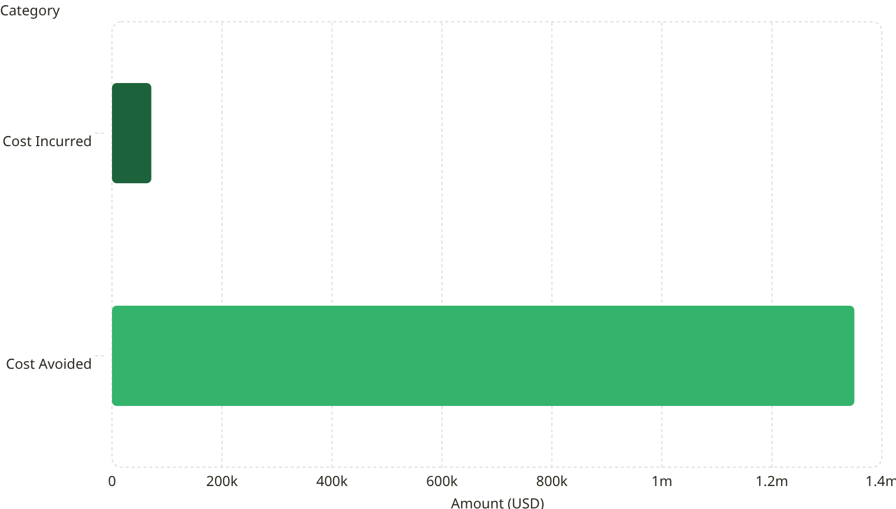
Visual Dashboard Summary
0 min
13 min
99%
1,888%
MTTD
MTTR
Detection Accuracy
ROI
Mean Time to Detect — Alert triggered immediately upon encryption
Mean Time to Respond — Containment initiated at 09:28 AM (Target: <15 min)
0 false positives
Return on security investment
Timeline
Cost Analysis
Detection: 09:15 AM (1 min)
Containment: 09:28 AM (13 min)
Eradication: 11:15 AM (1 hr 47 min)
Recovery: 12:30 PM (1 hr 15 min)
Report: 01:00 PM (30 min)
TOTAL: 4 hours 45 minutes
71.5k
Impact
Systems Affected: 3
Users Affected: 3
Files Encrypted: 2,793
Data Exfiltrated: 2.3 GB
Data Lost: 0 (RECOVERED)
Ransom Paid: $0 (NOT PAID)
1.35m
The Blue Team's rapid response incurred $71,500 in total costs while avoiding $1,350,000 in potential losses — delivering an ROI of 1,888%.
INCIDENT: RANSOMWARE (LOCKBIT 3.0)
STATUS: RESOLVED
SEVERITY: CRITICAL

